Slide 1
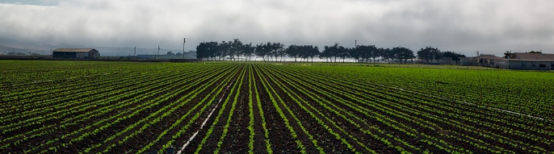
Crop Prediction Using ML
Presented By—
Adarsh Kumar
Abhishek Yadav
Ajay Kumar Poonia
Manjeet Kumar

Slide 2
Introduction
Machine learning is a type of artificial intelligence (AI) that provides
computers with the ability to learn without being explicitly programmed. The
proposed machine recommends a suitable crop given the parameters like
atmospheric humidity, temperature, soil moisture, soil pH, latitude, and longitude.
The system builds up a Decision Tree Classifier Model, which helps us decide
which crop to grow for the given data.

Slide 3
WHY ??
Agriculture is a business with risk and reliable crop yield prediction is vital
for decisions related to agriculture risk management.
The vision of meeting world’s food demands for the increasing population
throughout the world is becoming more important in these recent years.
Eventually, helps in achieving ZERO hunger.
Predictions could be used by crop managers to minimize losses when
unfavorable conditions may occur.

Slide 4
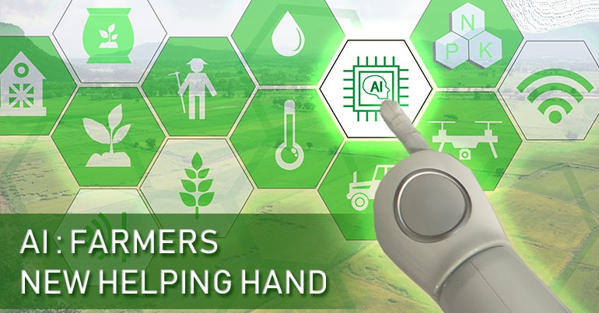
How??
The Agriculture sector is the foundation of the world’s economy and with the increasing population, the world will need to produce 50% more food by 2050.
AI-enabled technologies can help farmers get more from the land while using resources more sustainably.
With the help of AI, farmers can analyze a variety of things in real time such as weather conditions, temperature, water usage or soil conditions collected from their farm to better inform their decisions.

Slide 5
For example,
AI technologies help farmers optimize planning to generate more bountiful yields by determining crop choices, the best hybrid seed choices and resource utilization.
Agricultural Robots – Companies are developing and programming autonomous robots to handle essential agricultural tasks such as harvesting crops at a higher volume and faster pace than human laborers.
Crop and Soil Monitoring – Companies are leveraging computer vision and deep-learning algorithms to process data captured by drones and/or software-based technology to monitor crop and soil health.
Predictive Analytics – Machine learning models are being developed to track and predict various environmental impacts on crop yield such as weather changes.

Slide 6
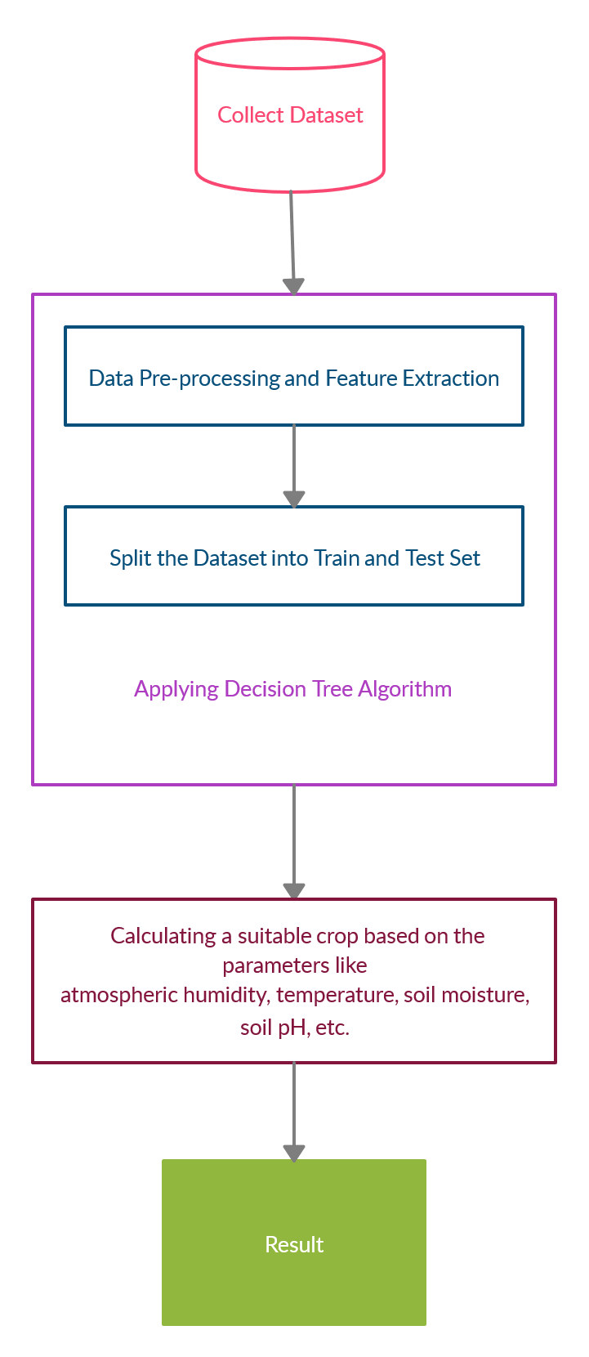
Proposed System—
In the proposed system, we use supervised to form a model, which recommends a suitable crop according to the given parameters.
It can be described in following stages such as:
A. Dataset collection,
B. Pre-processing step,
C. feature selection,
D. Split the dataset into train and test set,
E. Applying machine learning module,
F. Calculating and getting the result.

Slide 7
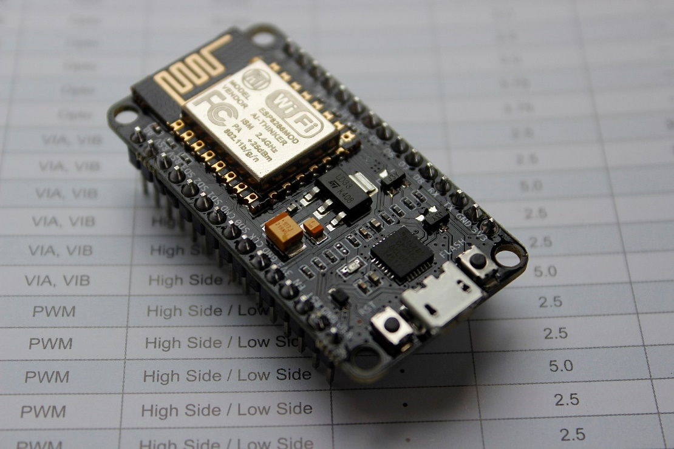
A. Dataset Collection-
GPS sensor modules integrated with the some advance platform (like NodeMCU) into a portable kit.
This kit is installed in the farm to gather the respective data of the soil.
The data gathered is transferred in real time to firebase database for storage and further processing.
NodeMCU

Slide 8
contd...
The atmospheric humidity, temperature, soil moisture, soil pH are sent as it is to the database from our installed kit.
The latitude and longitude sent by the GPS module is retrieved in the form of which part they fall under.
Location is used to retrieve rainfall data for that region.
http://www.indiawaterportal.org/met_data/
Above link can be used to get rainfall data of the particular location in India.
These are the datasets which can be used for predicting the Suitable Crop.

Slide 9
B. Pre-processing step-
This step is a very important step in machine learning.
Pre-processing consists of inserting the missing values, the appropriate data range, and extracting the functionality.
We can remove rows which are having null values.
Collection of more valid details of soil class, contours using image of the agricultural area can greatly accelerate the efficiency of work.
The Image Pre-processor can be used to remove the noise from the image (unwanted area).
This could then ease the work of Image Classifier Evaluator, to predict the soil class with improved accuracy.

Slide 10
C. Feature Selection-
Feature selection simplifies the amount of data involved to represent a large data set.
The soil and crop characteristics extracted from the pre-treatment phase constitute the final set of training.
These characteristics include the physical and chemical properties of the soil and area.
Here, we can use Random Forest Classifier for feature selection.
This method selects the features based on the entropy value i.e., the attribute which is having more entropy value is selected as important feature for crop prediction.

Slide 11
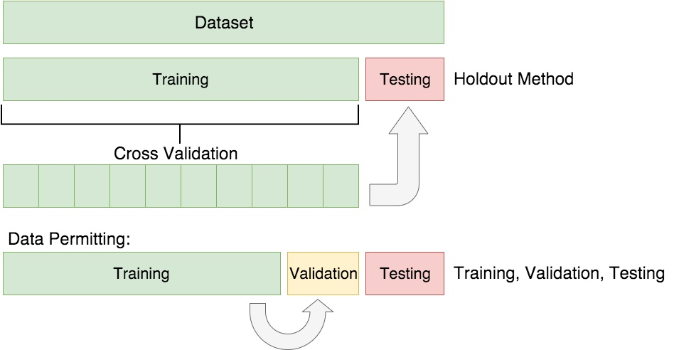
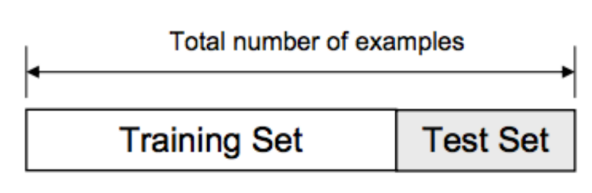
D. Split the Dataset into Train and Test Set-
This step includes training and testing of input data.
The loaded data is divided into two sets, such as training data and test data, with a division ratio of 80% or 20%, such as 0.8 or 0.2.
Cross Validation in order to prevent overfitting of model

Slide 12
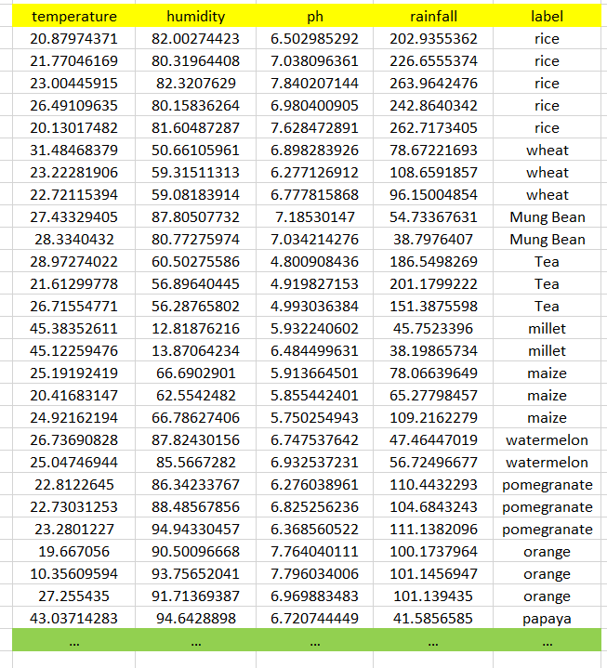
Part of our dataset:
Link to our full training and testing datasets is as follow:
URL: https://github.com/giriadarsh/Crop-Prediction-Using-Machine-Learning/blob/master/data.csv

Slide 13
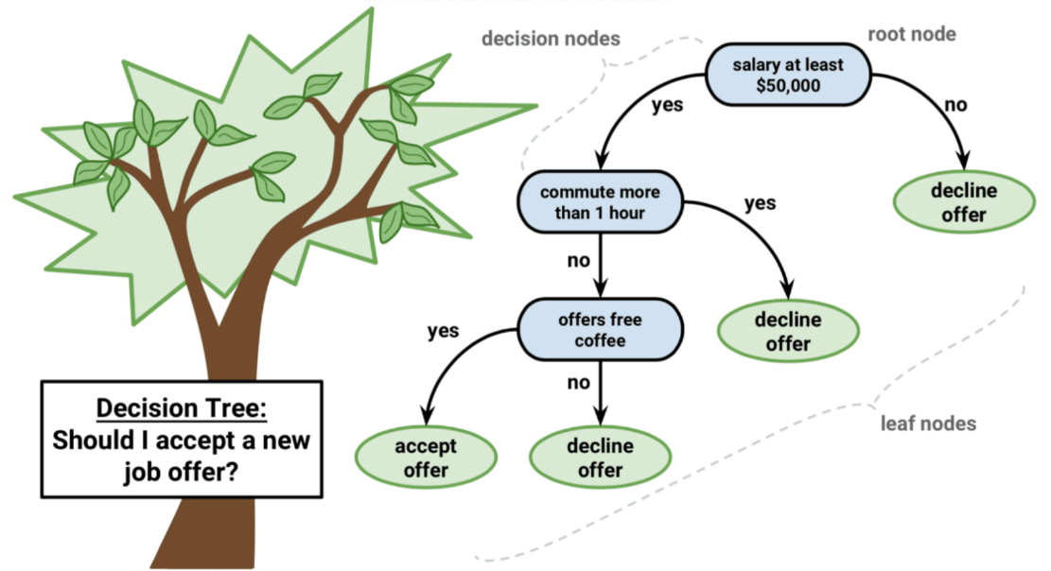
E. Applying Machine Learning module-
In our project we will use a supervised machine learning algorithm for crop yield prediction i.e..,
“Decision Tree Classifier”
A decision tree is a graphical representation of all the possible solutions to a decision based on certain conditions.
Decision Trees are a non-parametric supervised learning method used for both classification and regression tasks.

Slide 14
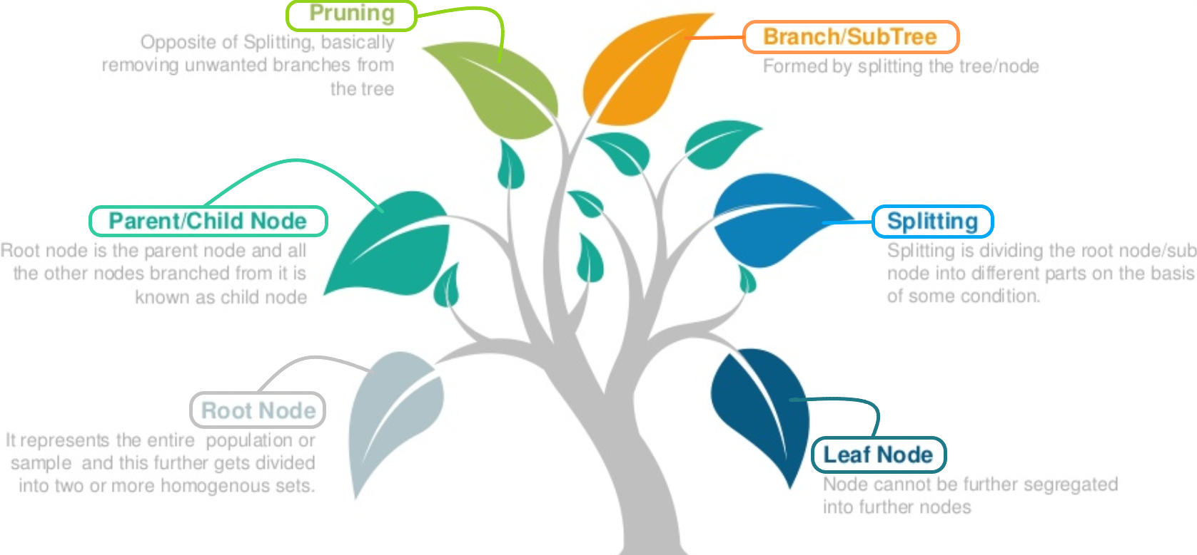
Decision Tree Terminology:

Slide 15
CART Algorithm:
There are various types of Decision tree algorithms such as C4.5,CART and ID3 algorithm. In this project, we are using CART algorithm for model building.
CART(Classification and Regression trees) was introduced by Breiman in 1984 .
In the implementation of CART, the dataset is split into the two subgroups that are the most different with respect to the outcome.
This procedure is continued on each subgroup until some minimum subgroup size is reached.
The factors like temperature, humidity, rainfall and soil pH can be used as input to prediction algorithm and the resultant will be in terms of crop name(as label).

Slide 16
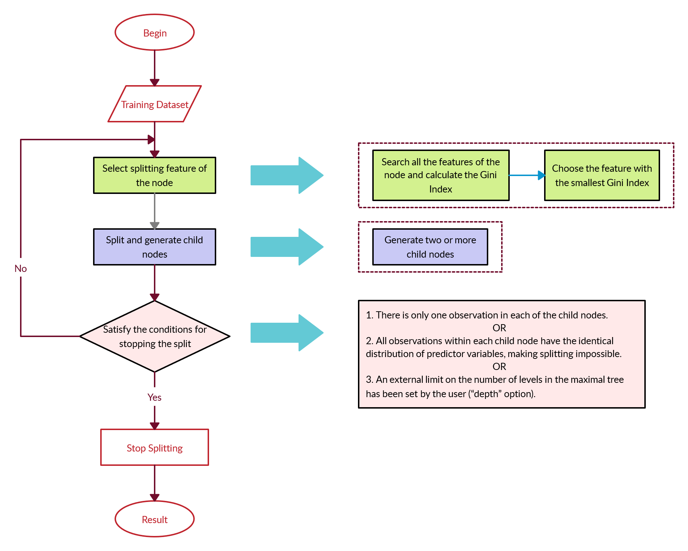
Flow Diagram

Slide 17
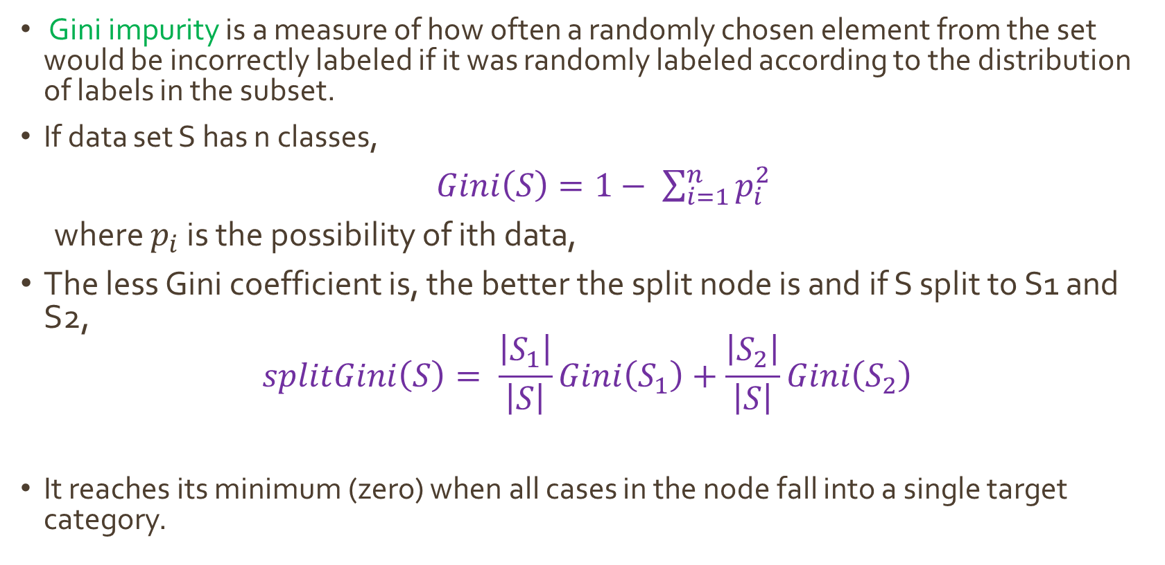
Splitting Criterion-
Gini impurity is a measure of how often a randomly chosen element from the set would be incorrectly labeled if it was randomly labeled according to the distribution of labels in the subset.
If data set S has n classes,
$Gini\left(S\right)=1− \sum_{i=1}^{n}{p_{i}^{2}}$
where $p_{i}$ is the possibility of ith data,
The less Gini coefficient is, the better the split node is and if S split to S1 and S2,
$$splitGini\left(S\right)= \frac{\left|S_{1}\right|}{\left|S\right|}Gini\left(S_{1}\right)+\frac{\left|S_{2}\right|}{\left|S\right|}Gini\left(S_{2}\right)$$
It reaches its minimum (zero) when all cases in the node fall into a single target category.

Slide 18
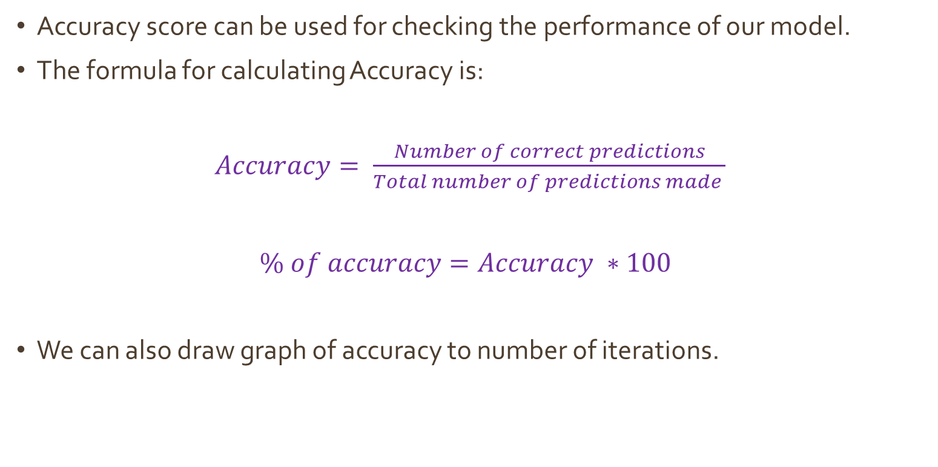
Performance:
Accuracy score can be used for checking the performance of our model.
The formula for calculating Accuracy is:
$Accuracy= \frac{Number of correct predictions}{Total number of predictions made }$
$\% of accuracy=Accuracy ∗100$
We can also draw graph of accuracy to number of iterations.

Slide 19

F. Expected output and outcome of the Proposal-
The proposed machine recommends a suitable crop given the parameters like atmospheric humidity, temperature, soil moisture, soil pH, latitude, and longitude.
It will help in agricultural planning.
Farmers can take the right decision for choosing the right crop before cultivating onto the field.
It will help in reducing loss of crop thus reducing hunger.

Slide 20
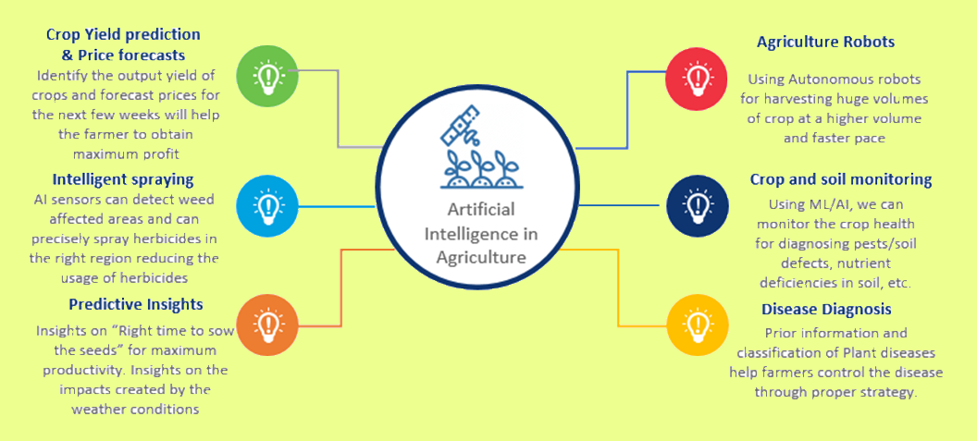
Future Works—

Slide 21
State of the Art—
Agriculture plays a vital role in India’s economy.
Over 58 percent of the rural households depend on agriculture as their principal means of livelihood, according to an IBEF report.
Agricultural exports constitute 10 percent of the country’s exports and is the fourth-largest exported principal commodity category in India.
Some applications of artificial intelligence (AI) which are currently in use or under development are shown in next few slides.

Slide 22
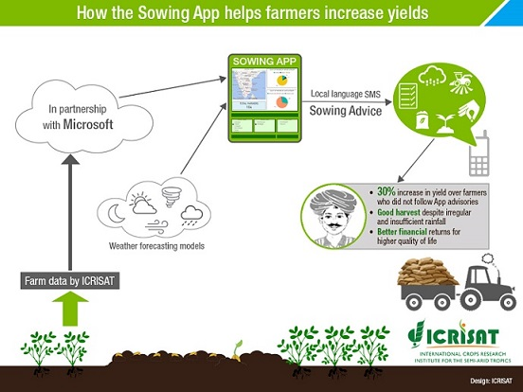
1. The AI sowing app:
Microsoft in collaboration with ICRISAT, developed an AI Sowing App Machine Learning and Power BI.
The app sends sowing advisories to participating farmers on the optimal date to sow.
The farmers don’t need to install any sensors in their fields or incur any capital expenditure.
All they need is a feature phone capable of receiving text messages.

Slide 23
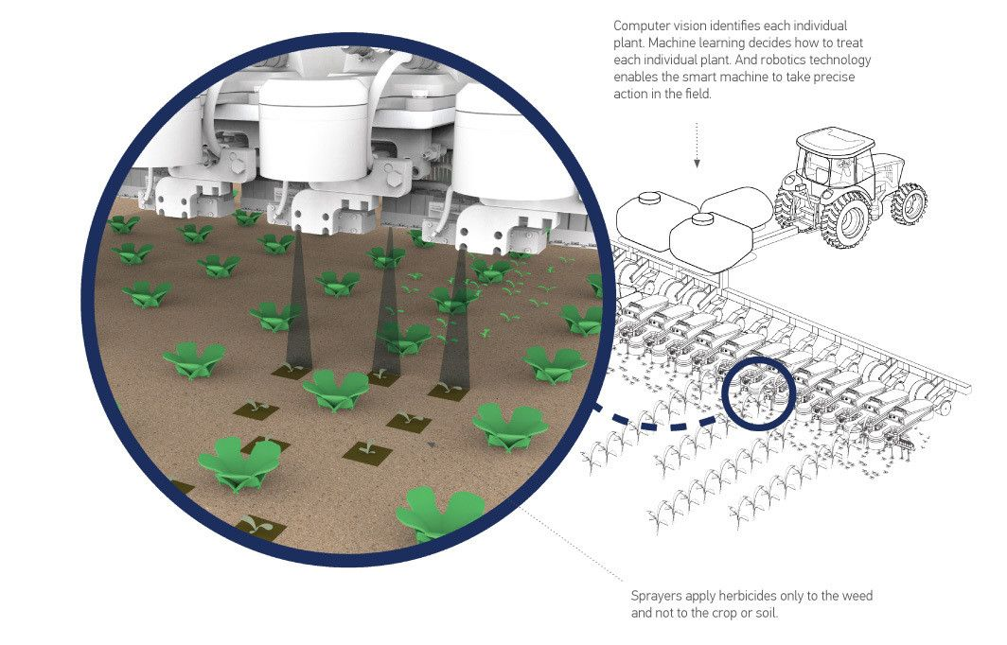
2. AI for herbicide optimization:
Blue River Technology has designed and integrated computer vision and machine learning technology that enables farmers to reduce the use of herbicides by spraying only where weeds are present
It helps in optimizing the use of inputs in farming.
Lower herbicide costs by 90% when selectively applying herbicide to weeds only.
https://www.youtube.com/watch?v=XH-EFtTa6IU

Slide 24
More applications:
AI for Precision Farming: NITI Aayog and IBM have partnered to develop a crop yield prediction model using AI to provide real time advisory to farmers. https://www.youtube.com/watch?v=hhoLSI4bW_4
AI-based predictive analytics — Greenhouse Guardian: Developed by Bosch technology specifically for agriculture, Greenhouse Guardian is a data-based early-warning system that alerts farmers to the potential risk of crop infection.
https://youtu.be/abJS4v-UX7A
AgVerdict: AgVerdict combines field-specific data with their agronomists’ knowledge for a strategic decision-making toolkit to help farmers make better decisions and increase productivity.
https://agverdict.com/

Slide 25
Conclusion:
It’s important to understand that machine learning, like other technologies, is a part of a process, not a stand-alone solution.
Our proposed model in many ways providing practical applications that align with existing agricultural operations.
Farmers can easily decide which crop to cultivate, enhancing the productivity and profitability.
They can make pre-arrangements about the crop requirements such as pesticides, irrigation facility, soil maintenance etc.
Once, the idea makes it momentum in this field more new ideas can be added into it, enhancing the model.

Slide 26
Bibliography:
https://github.com/giriadarsh/Crop-Prediction-Using-Machine-Learning/blob/master/data.csv
https://www.ibef.org/industry/agriculture-india.aspx
https://news.microsoft.com/en-in/microsoft-announces-ai-for-earth-grant-recipients-from-india-and-deepens-commitment-to-sustainability-in-the-country/
https://youtu.be/GSvT940uS_8
https://www.youtube.com/watch?v=hhoLSI4bW_4
https://niti.gov.in/writereaddata/files/document_publication/NationalStrategy-for-AI-Discussion-Paper.pdf
https://www.bosch.com/stories/greenhouse-guardian-ai-in-agriculture/
https://youtu.be/abJS4v-UX7A
https://agverdict.com/

Slide 27


